Slide 1
Decision Trees

Slide 2
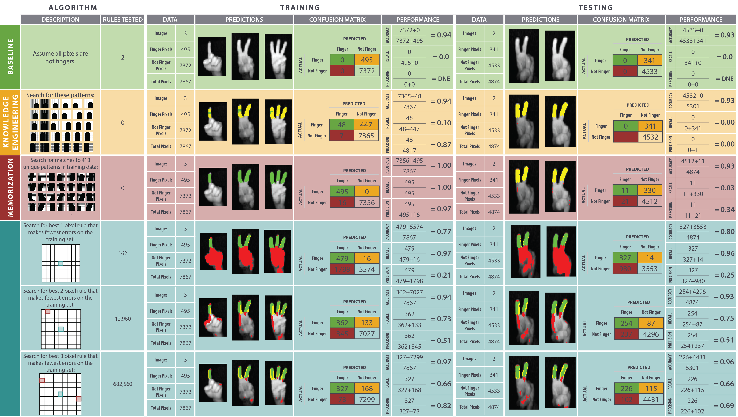
Notes:
Last time we ended up here-ish. We found a good approach, but it was way too slow!

Slide 3
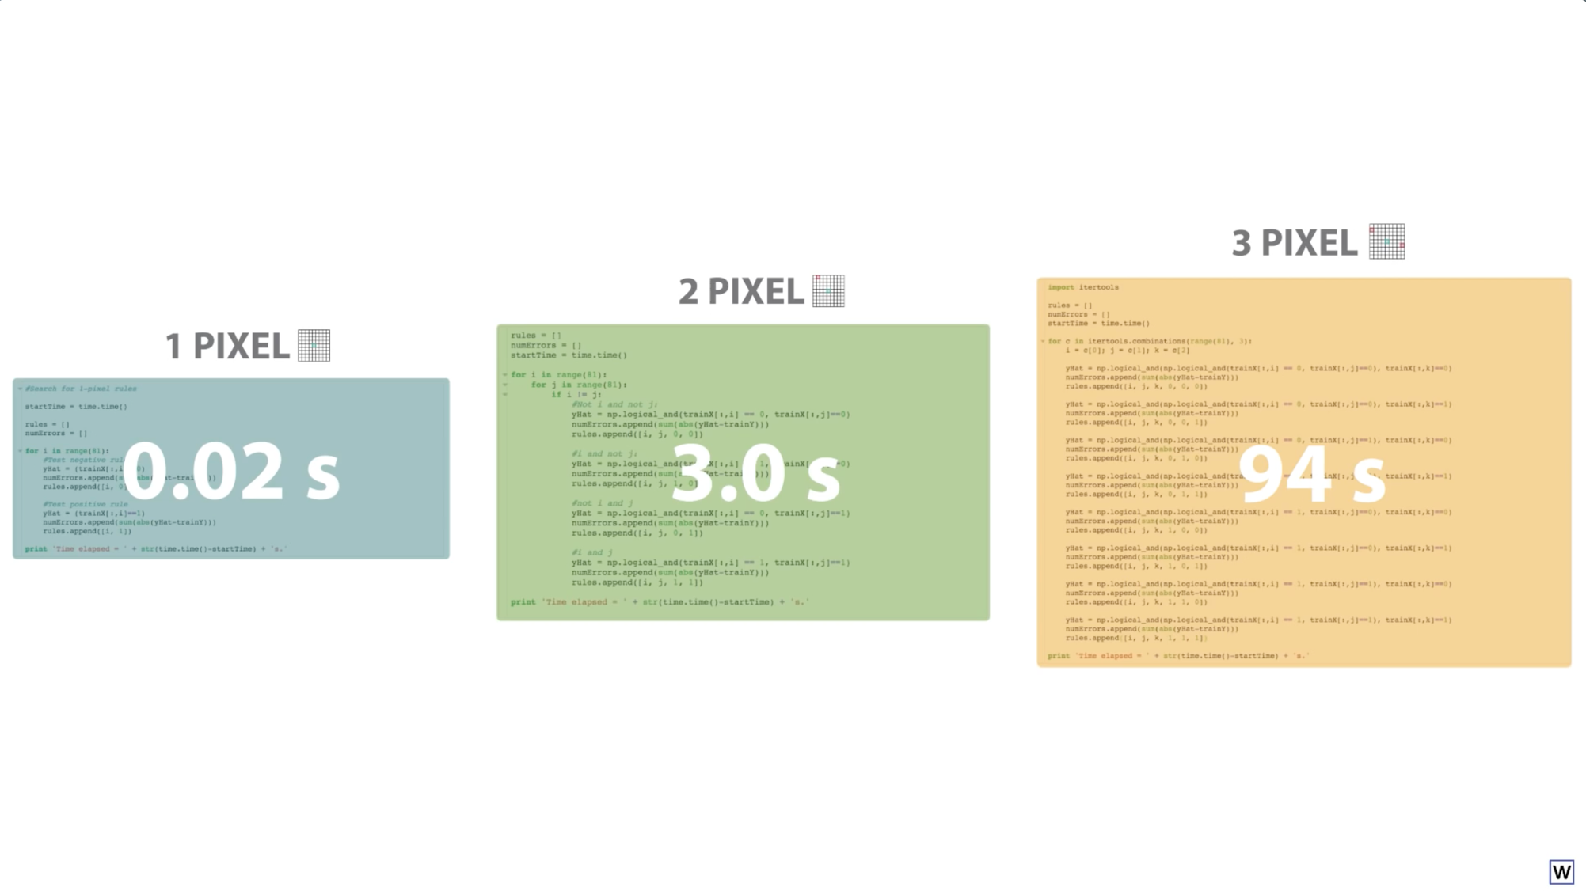
As we search for rules that use more of our 81 pixels, things really start to slow down. Why?

Slide 4
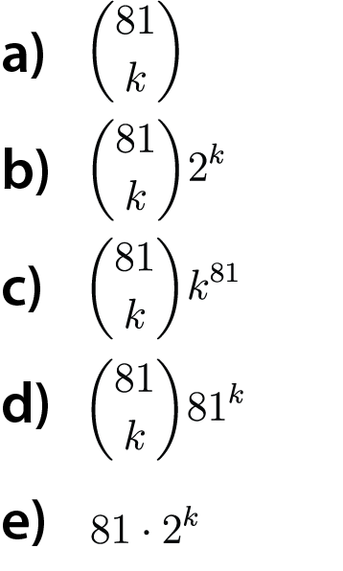
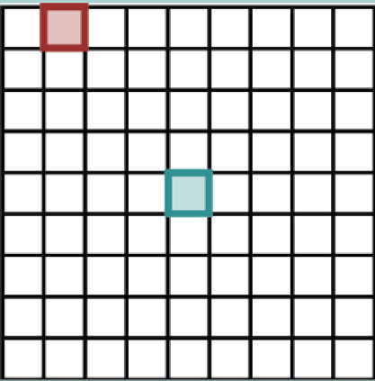
How many k-pixel rules exist for our 9x9 examples?
Example rule for k=2

Slide 5
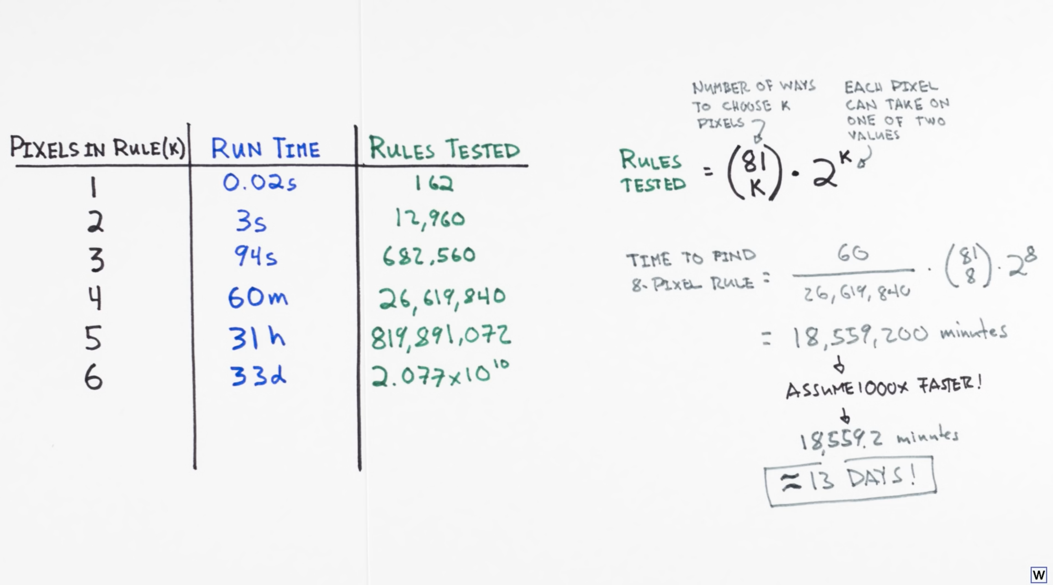
Exponential Growth be ridiculous.

Slide 6
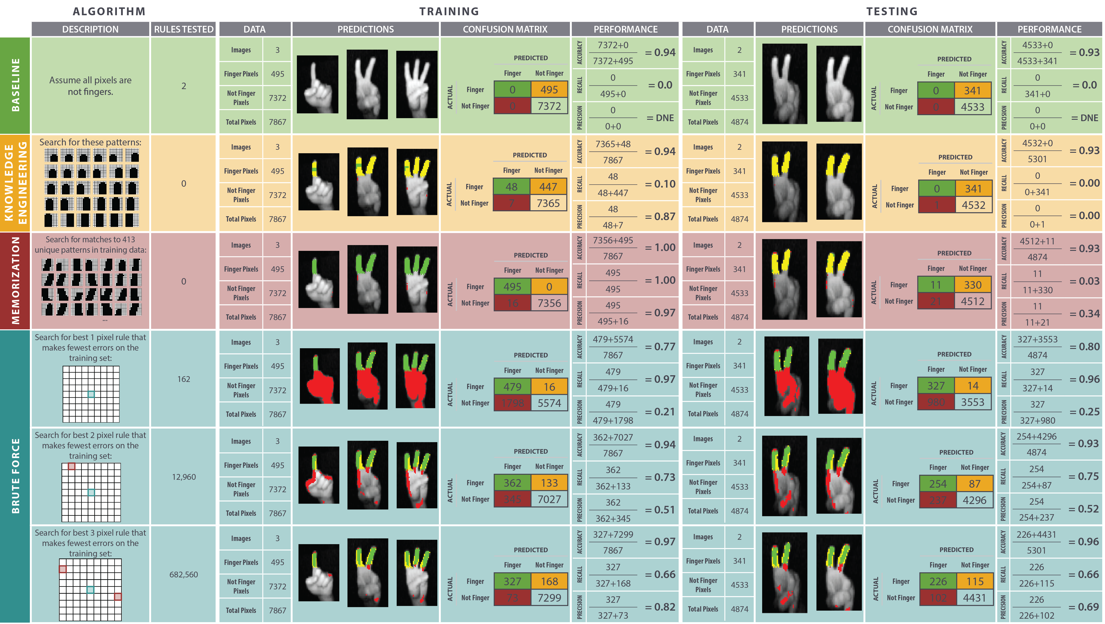
Notes:
Check out how the numbers of rules we’re testing increases with pixels – this approach does not scale.

Slide 7
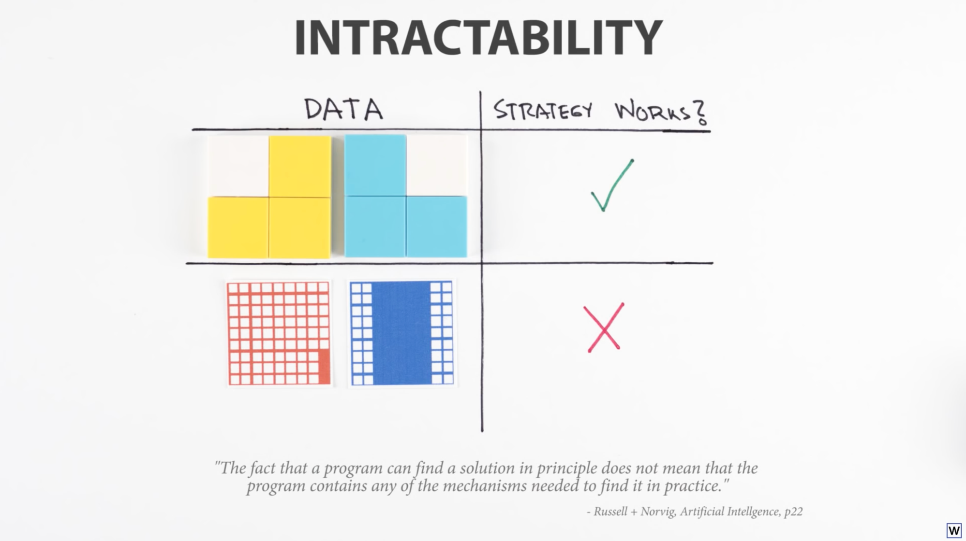
Notes:
The word for this inability to scale is intractability. It’s a big deal.

Slide 8
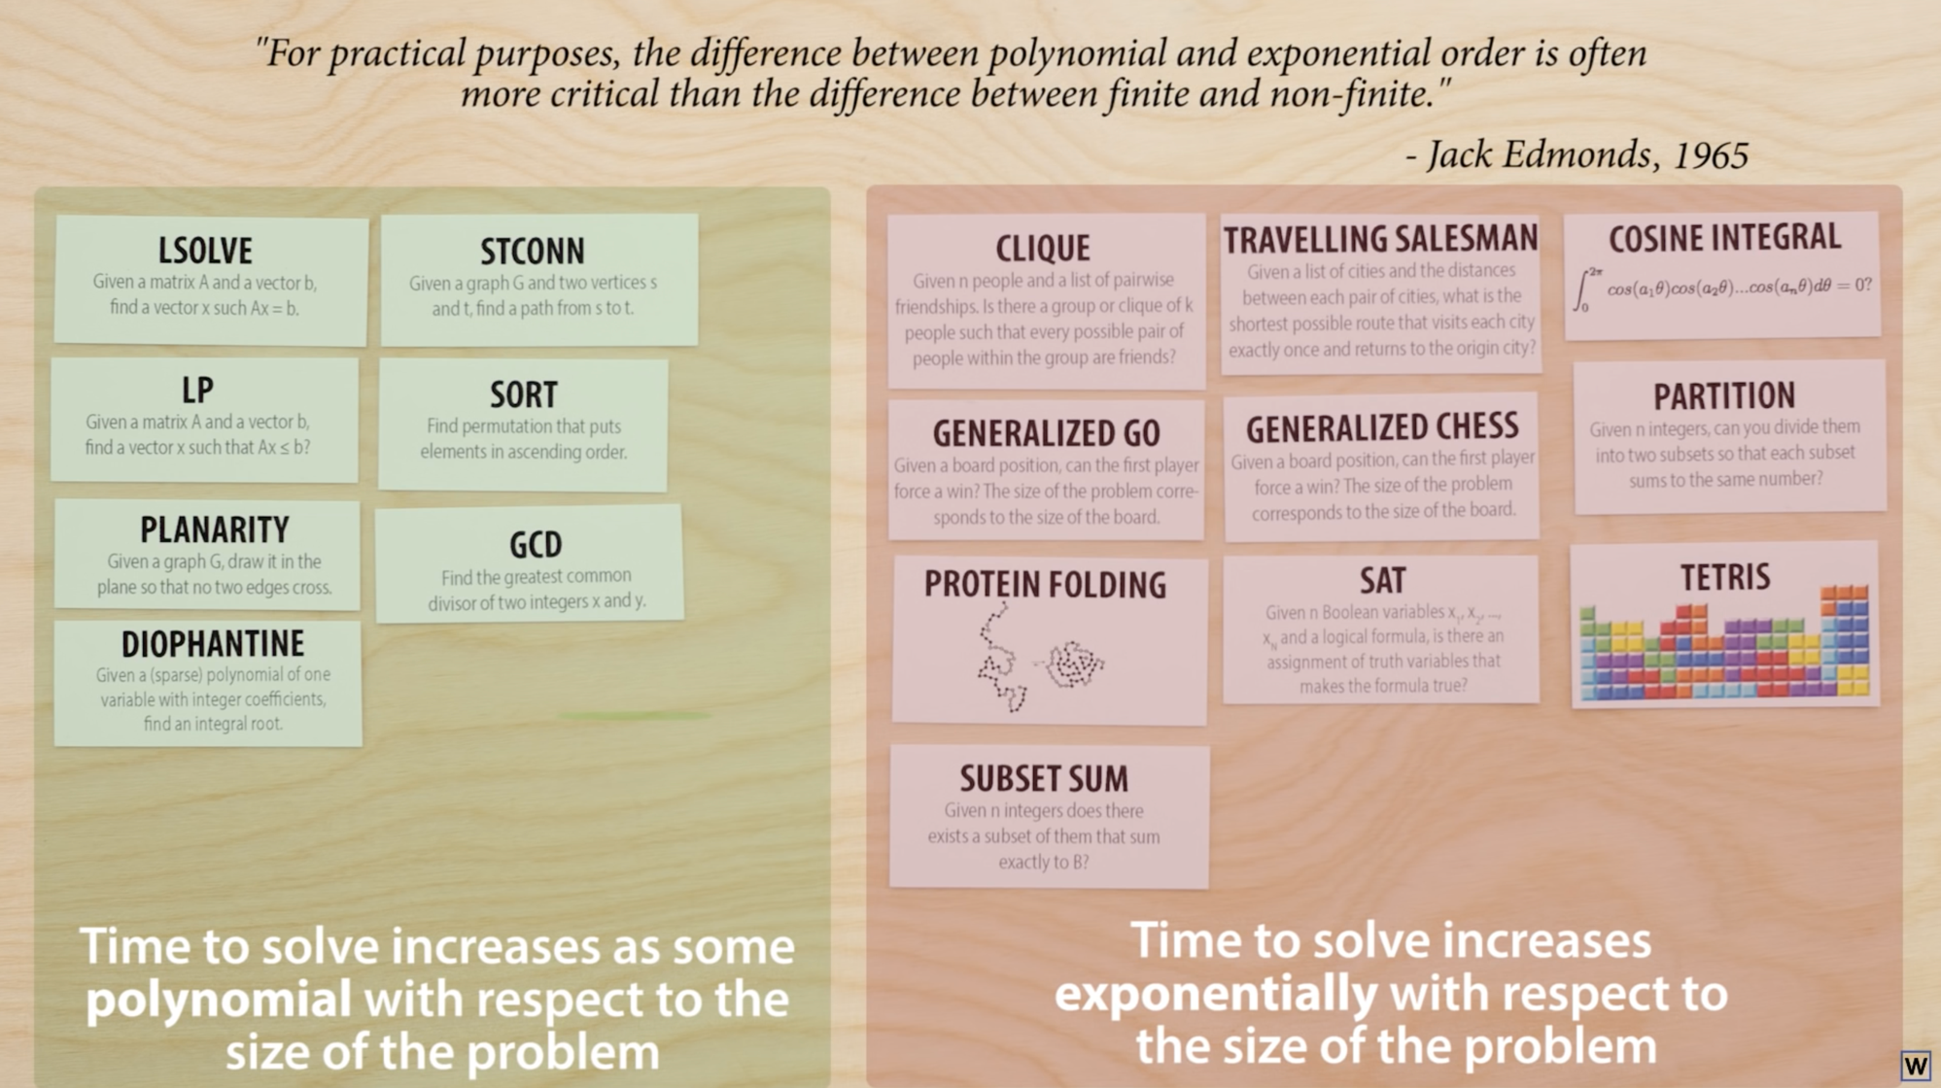
Notes:
Interestingly, many of the problems we care to solve naturally fall into 2 classes.

Slide 9
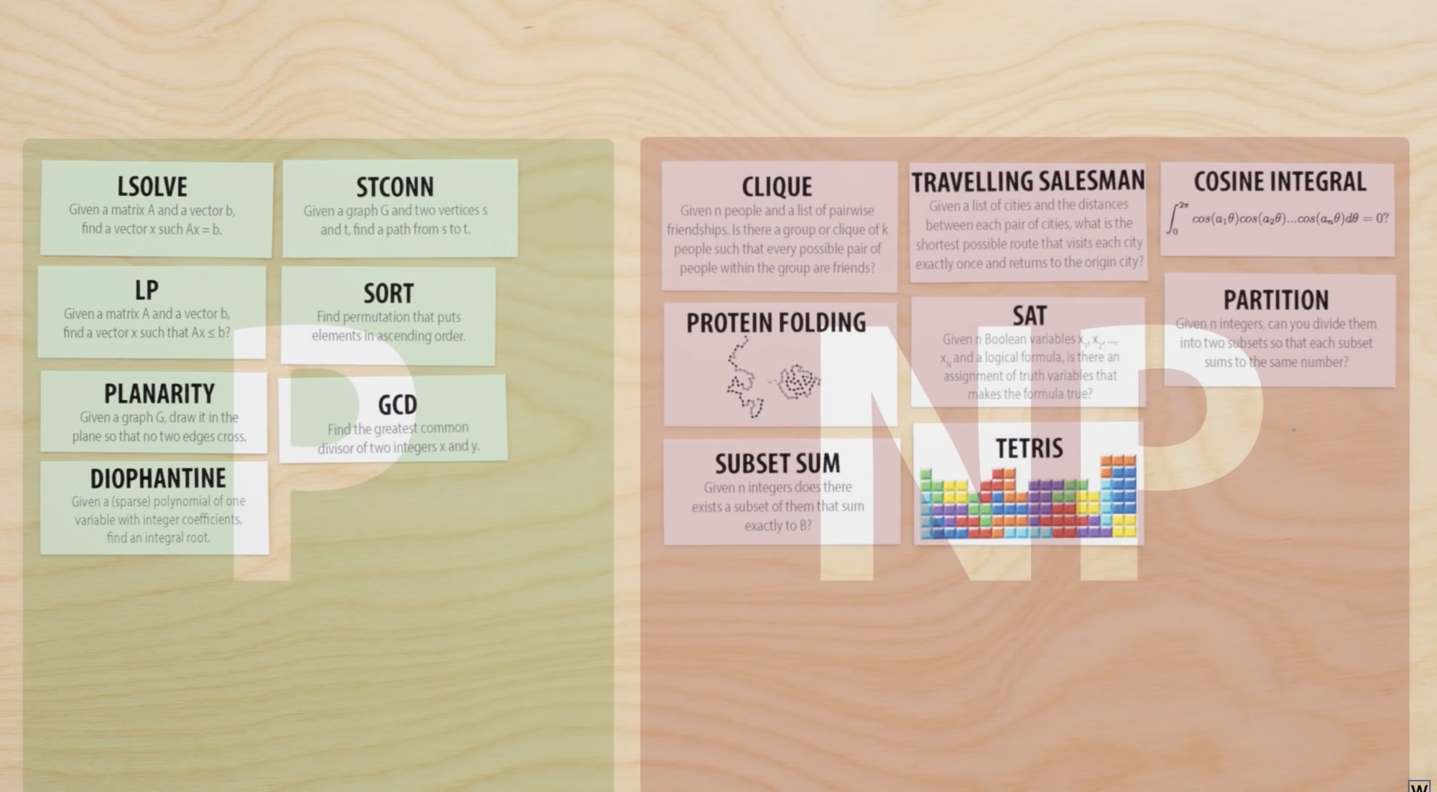
It’s a little more complicated than this…but many of the problems that become exponentially hard belong to the complexity class NP.

Slide 10
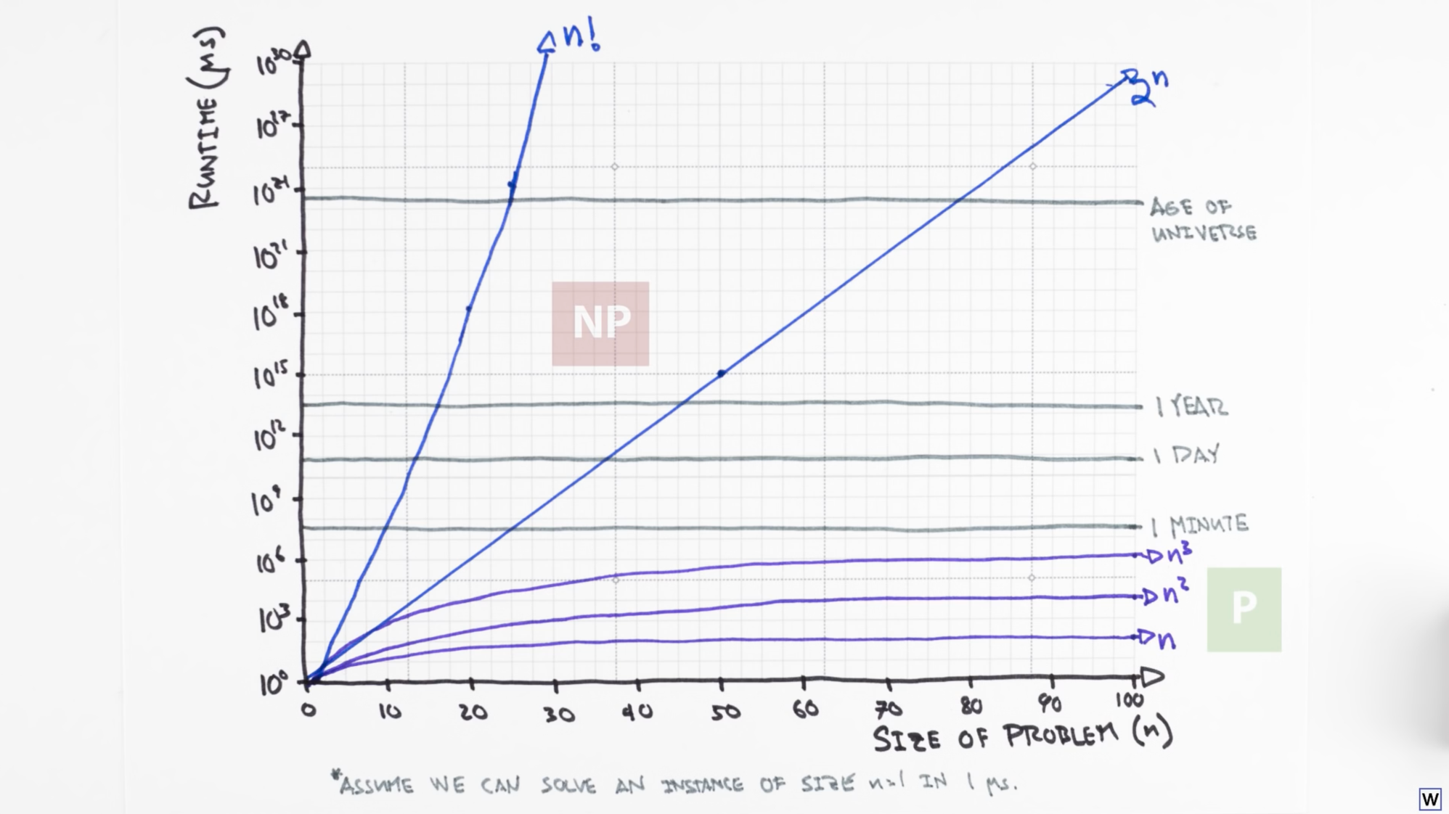

Slide 11

Notes:
No one knows if P=NP, and if you provide a proof either way, the Clay Mathematics institute will give you $1M.

Slide 12
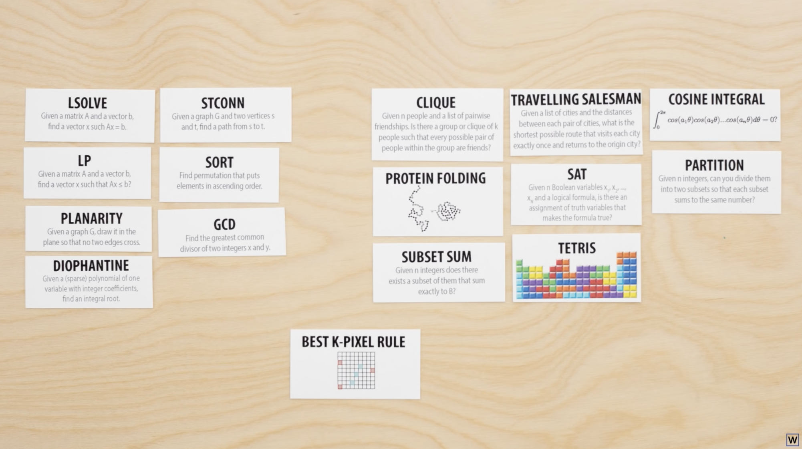
Is our problem in P or NP?

Slide 13
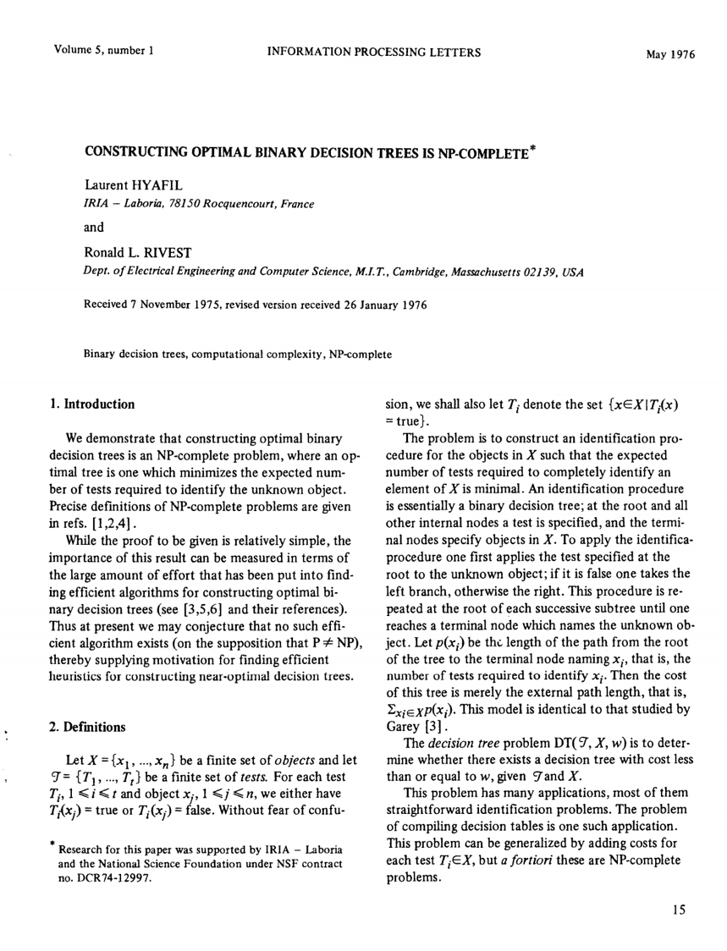
So…I have some bad news for you.

Slide 14

However, in the 70s and 80s these researchers (independently) found a very good approximate solutions to our problem. Let’s see how.

Slide 15
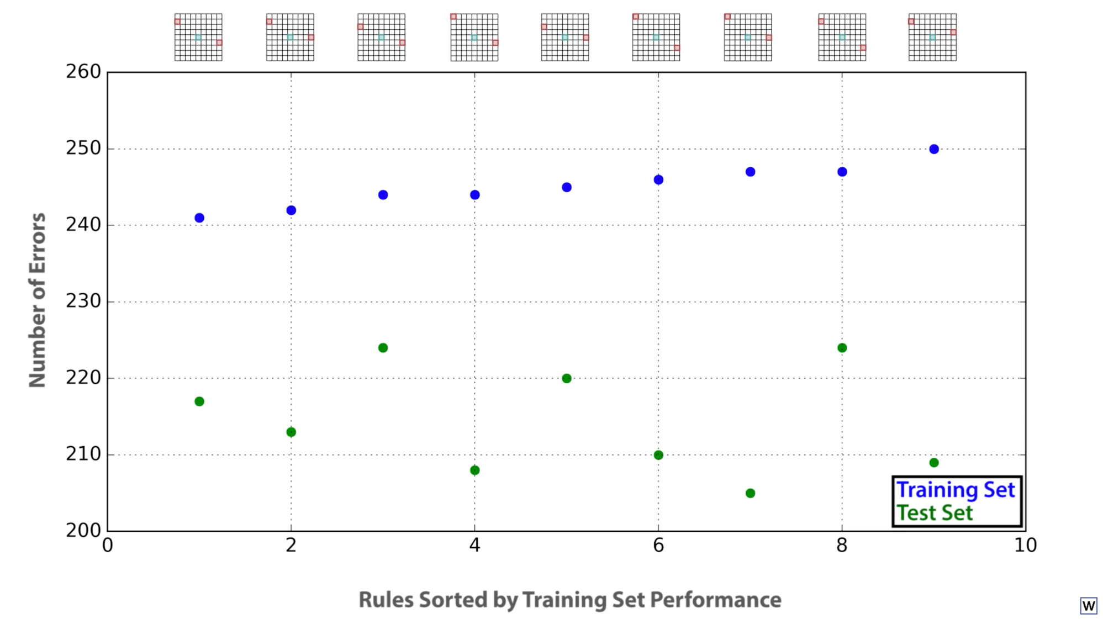
Notes:
First, there isn’t really 1 best rule. This will allow us to really speed things up!

Slide 16
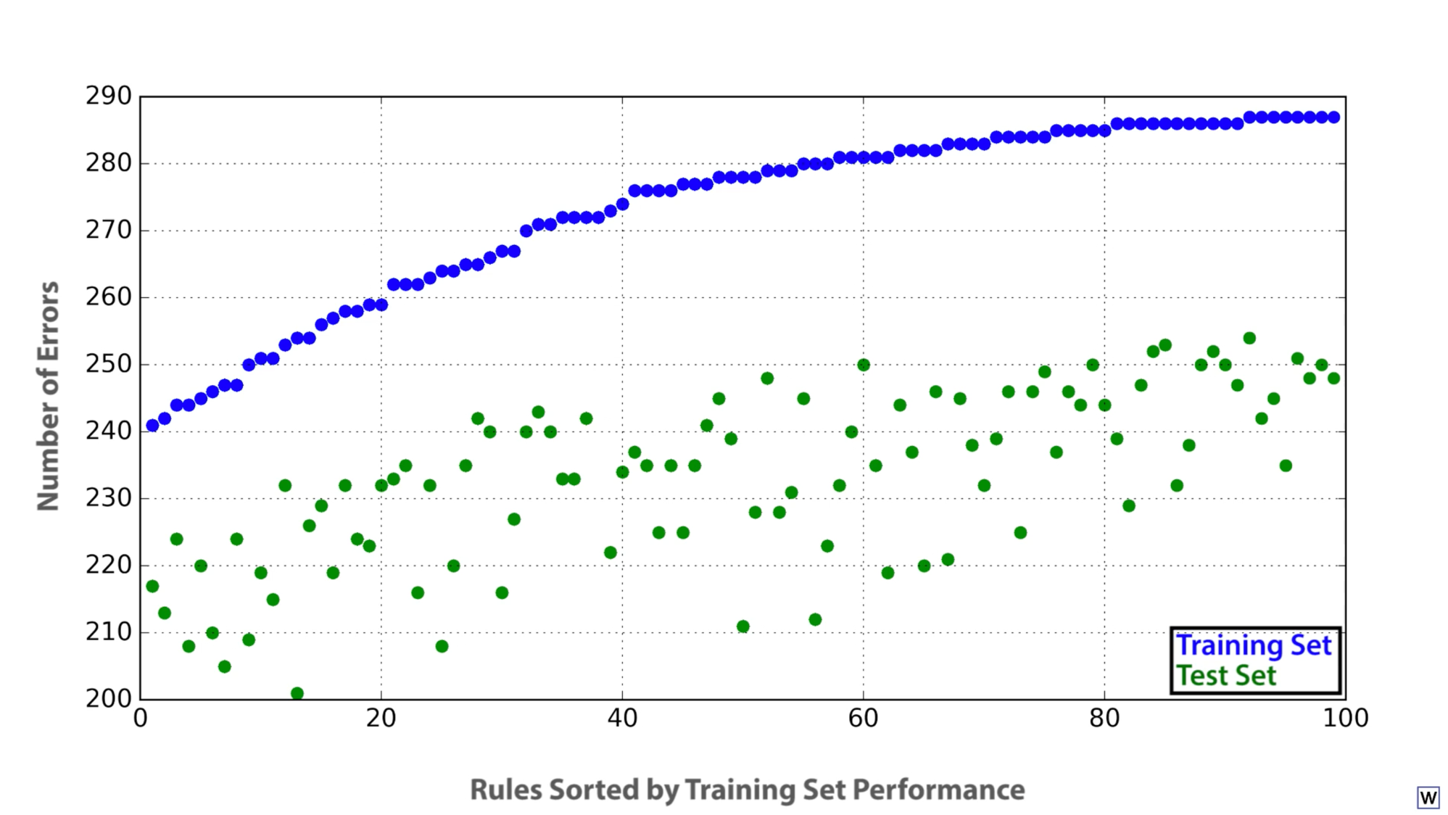

Slide 17
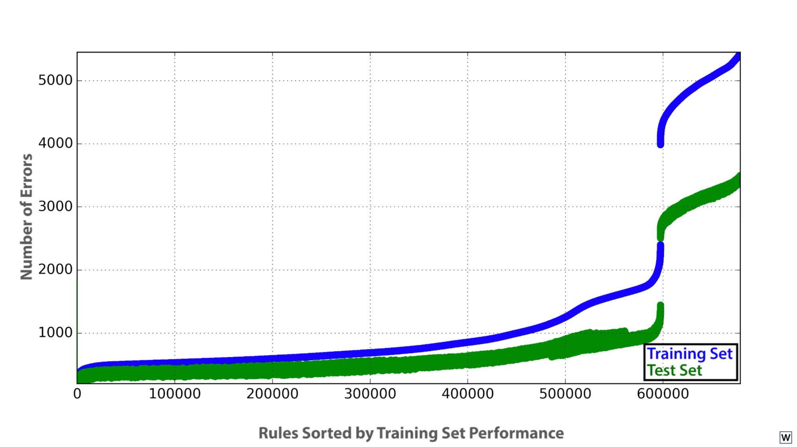

Slide 18
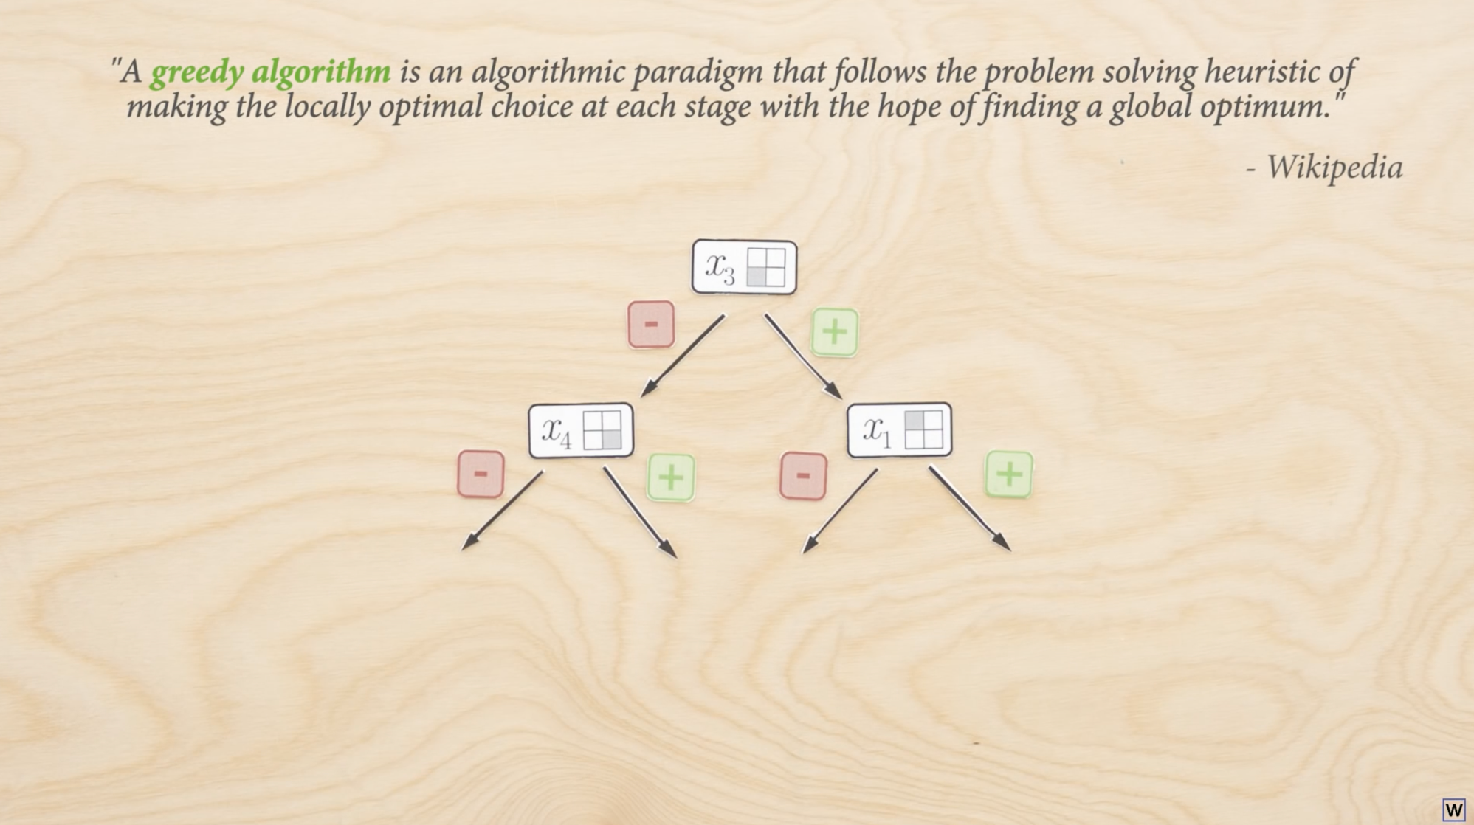
The first big idea here is to greedily build our rules one pixel at a time.

Slide 19
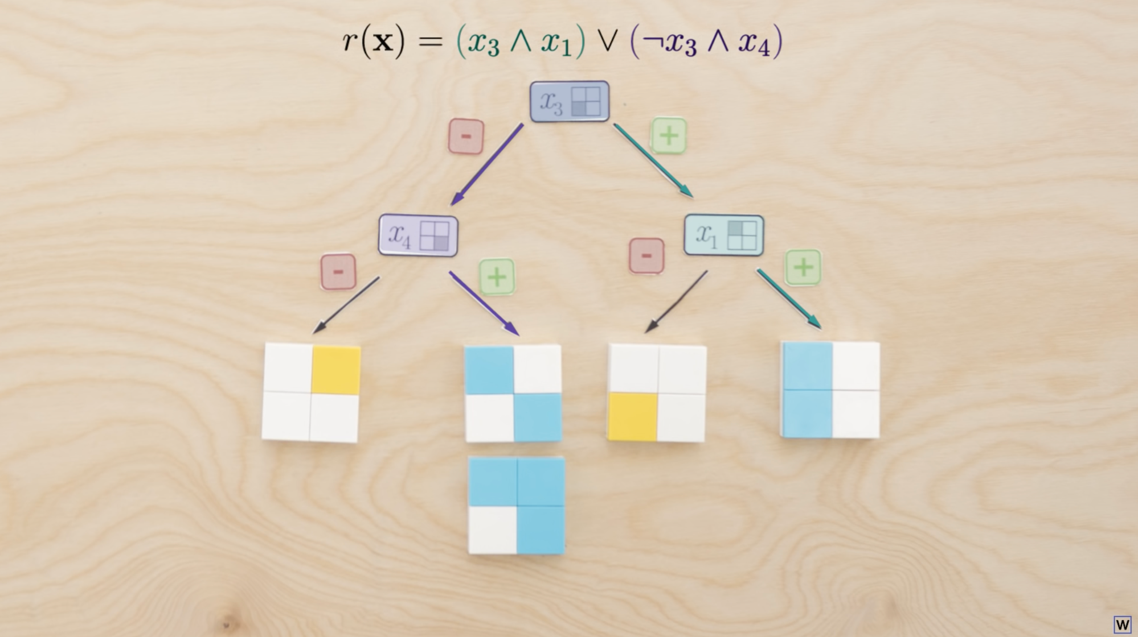
Trees are a nice way to express (and learn) the type of rules we’ve been discussing.

Slide 20
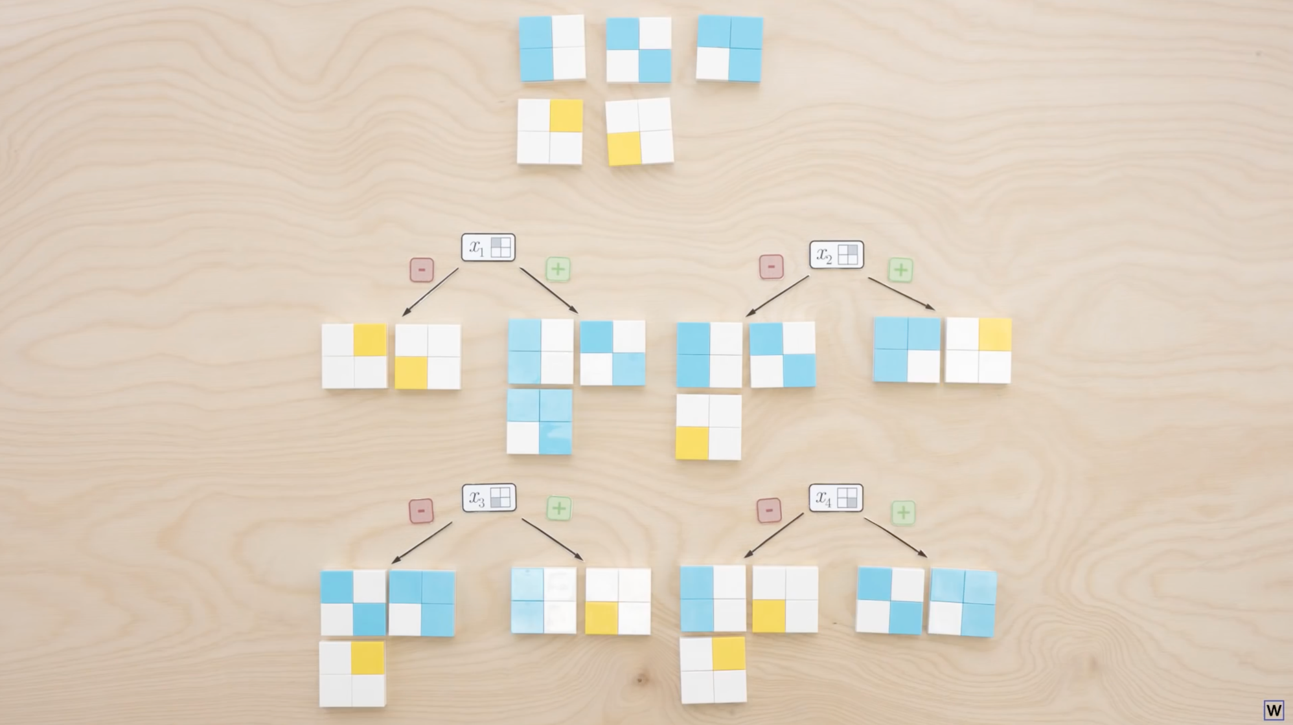
So we want to grow our trees/build our rules one pixel at a time, but how do we choose which split is best? Which one of these splits is best?

Slide 21
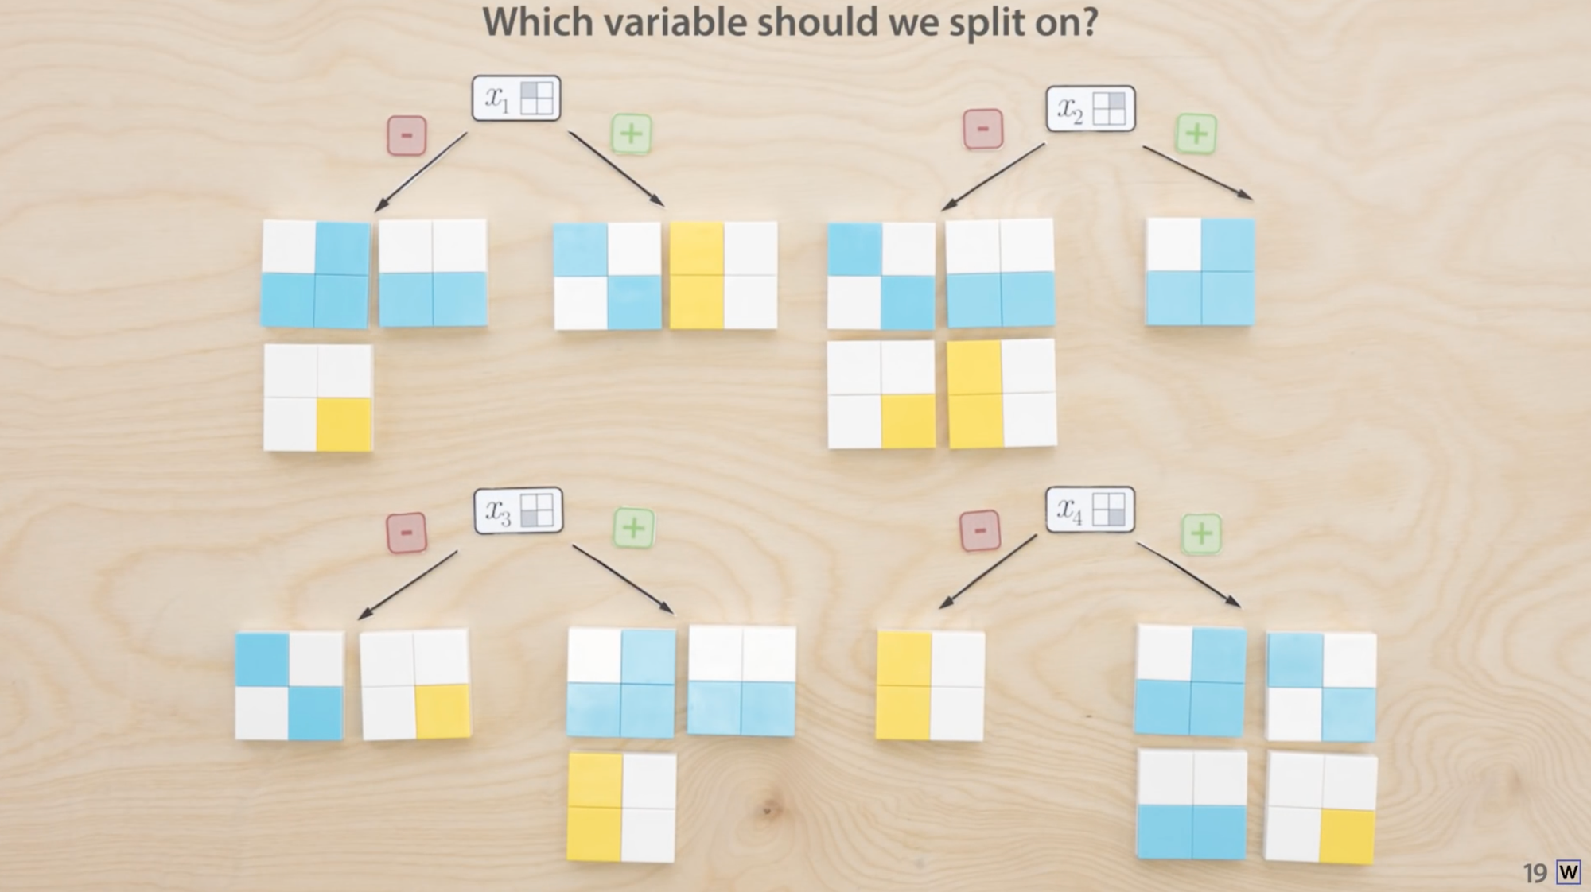
How about now?

Slide 22
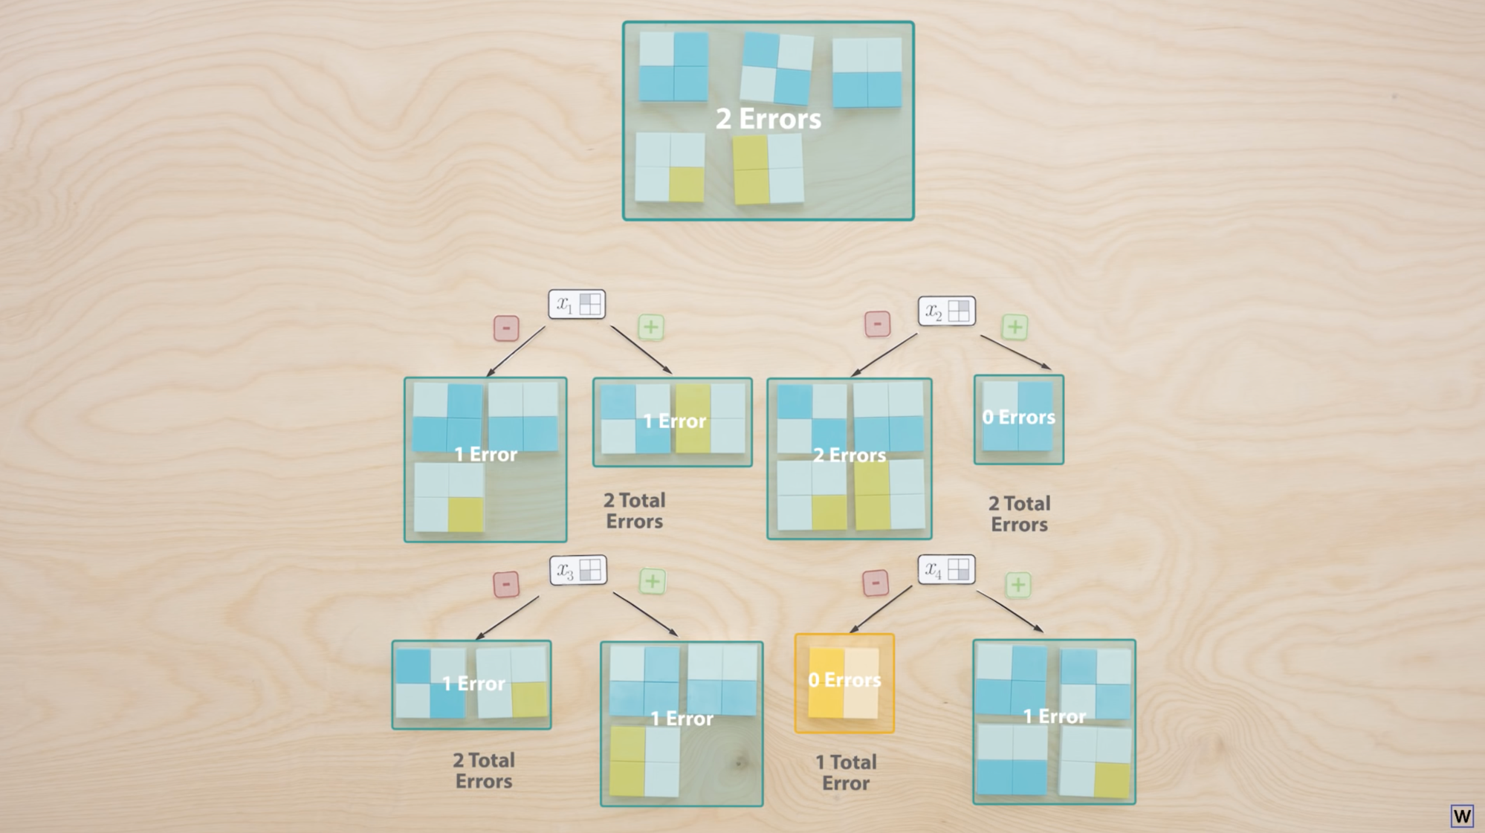
One way to choose good splits is to count the number of errors after labeling each leaf with the majority class.

Slide 23
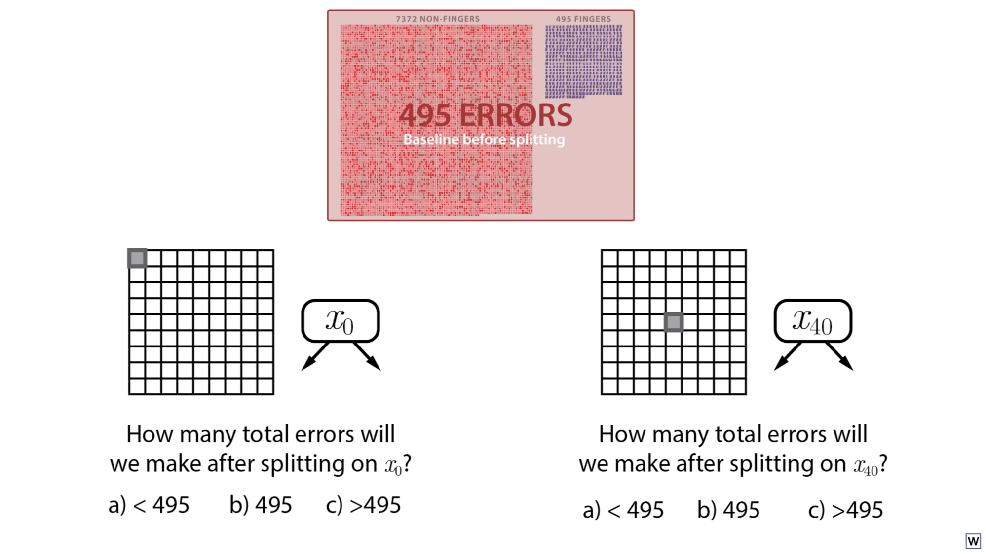
Notes:
We can try this on our real data!

Slide 24
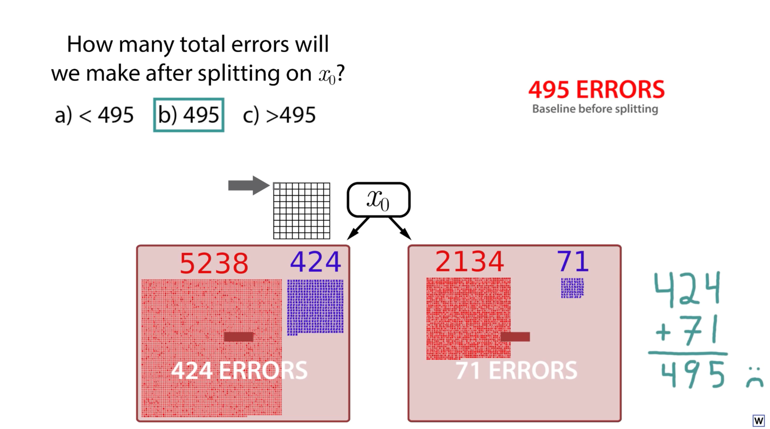

Slide 25
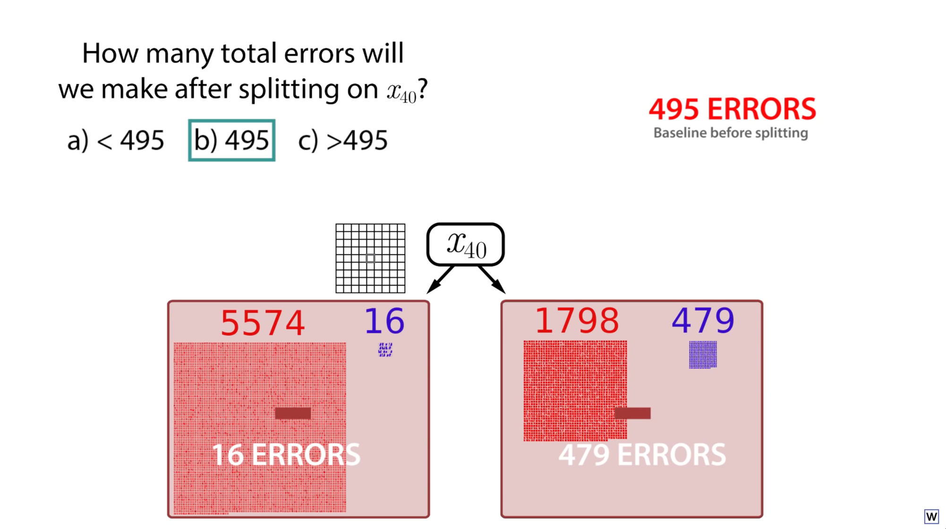

Slide 26
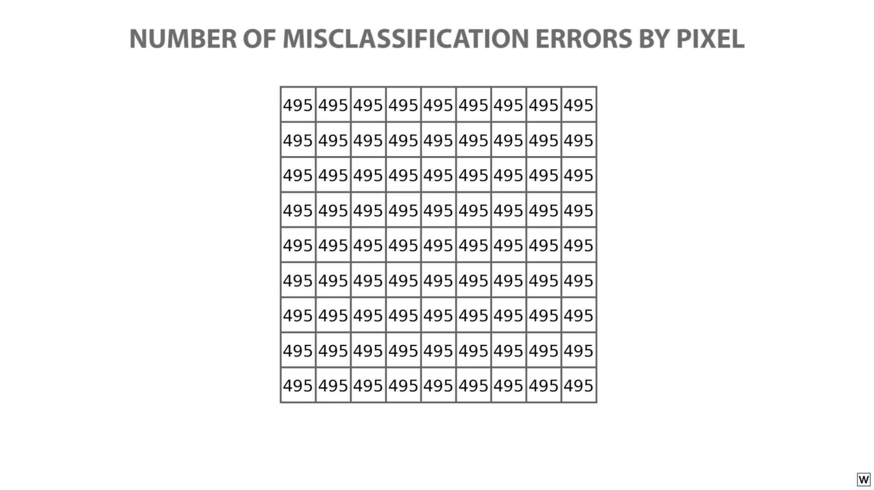
Well, shit.

Slide 27
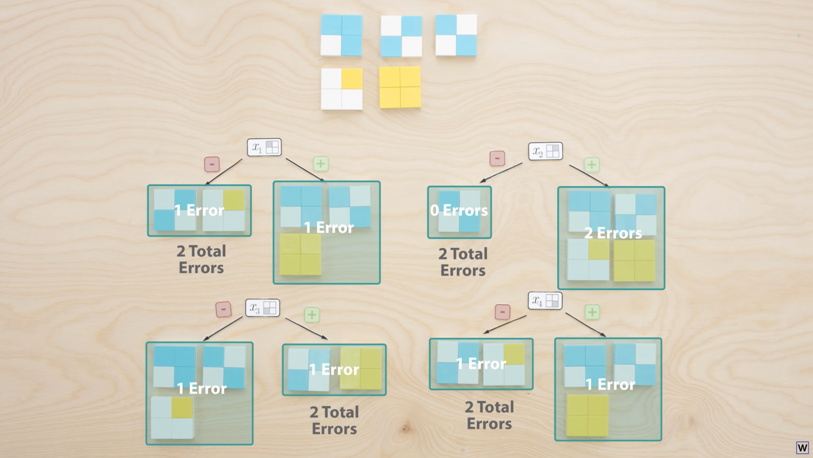
Here’s the toy data version of the same problem. Maybe there’s a better way to measure the quality of each split?

Slide 28
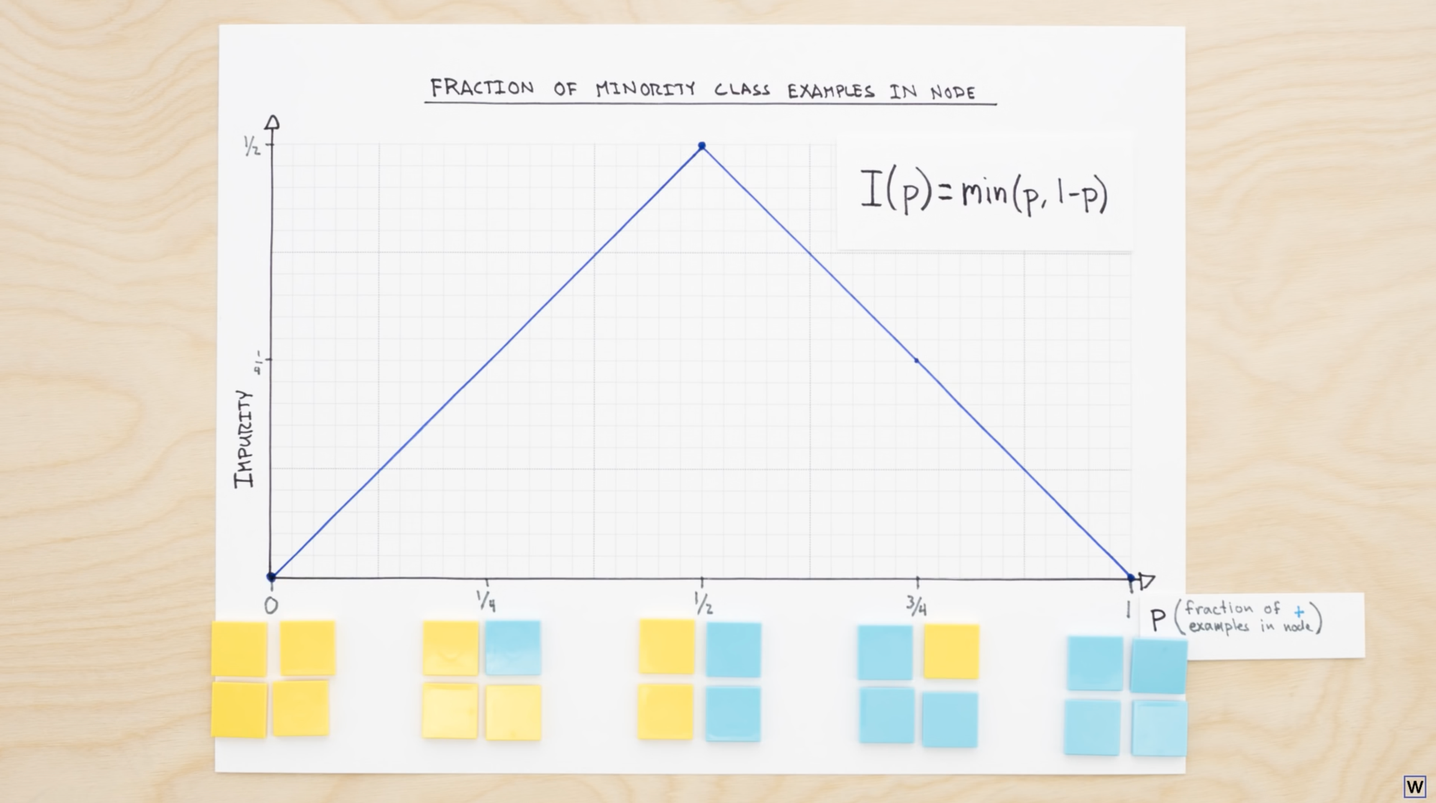
Here’s one way we could measure impurity – the minority class faction.

Slide 29
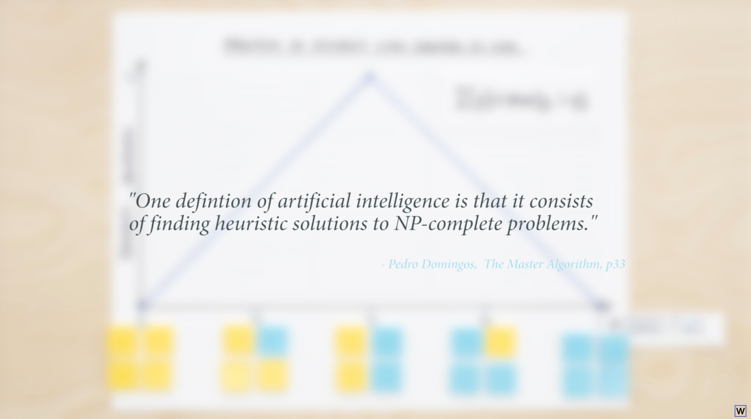
This is of course, just a heuristic, but it might serve use well!

Slide 30
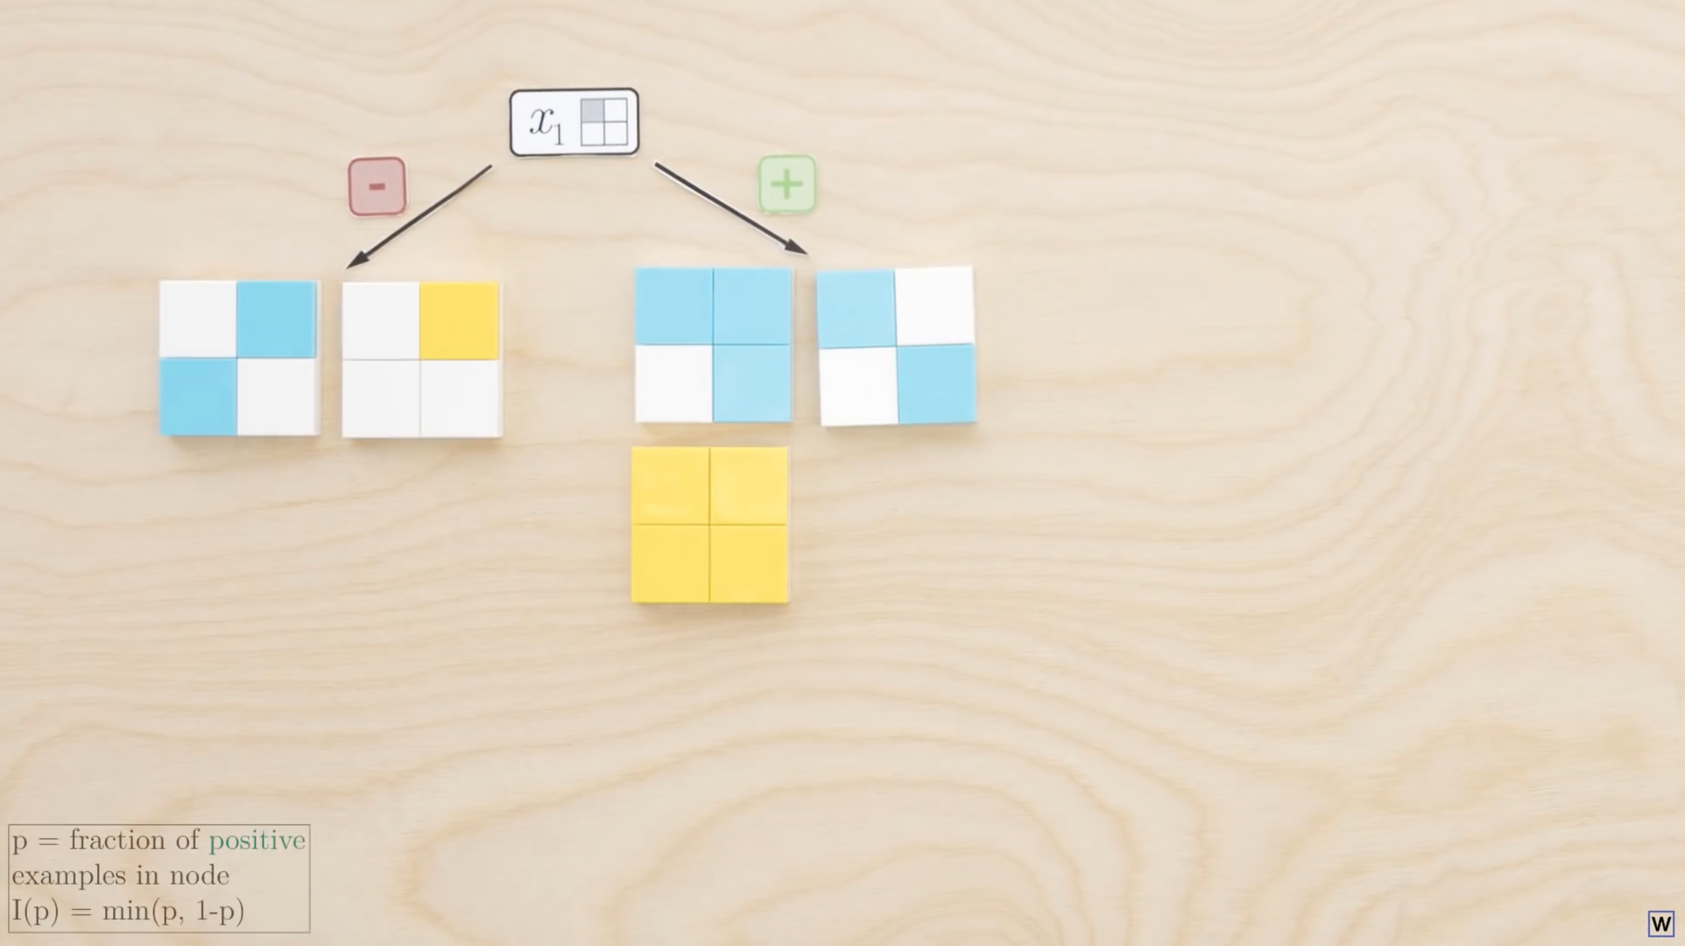
Using our impurity heuristic, what is the impurity of our left node?
1/5
1/3
1/2
2/5
3/5

Slide 31
Using our impurity heuristic, what is the impurity of our right node?
1/5
1/3
1/2
2/5
3/5

Slide 32
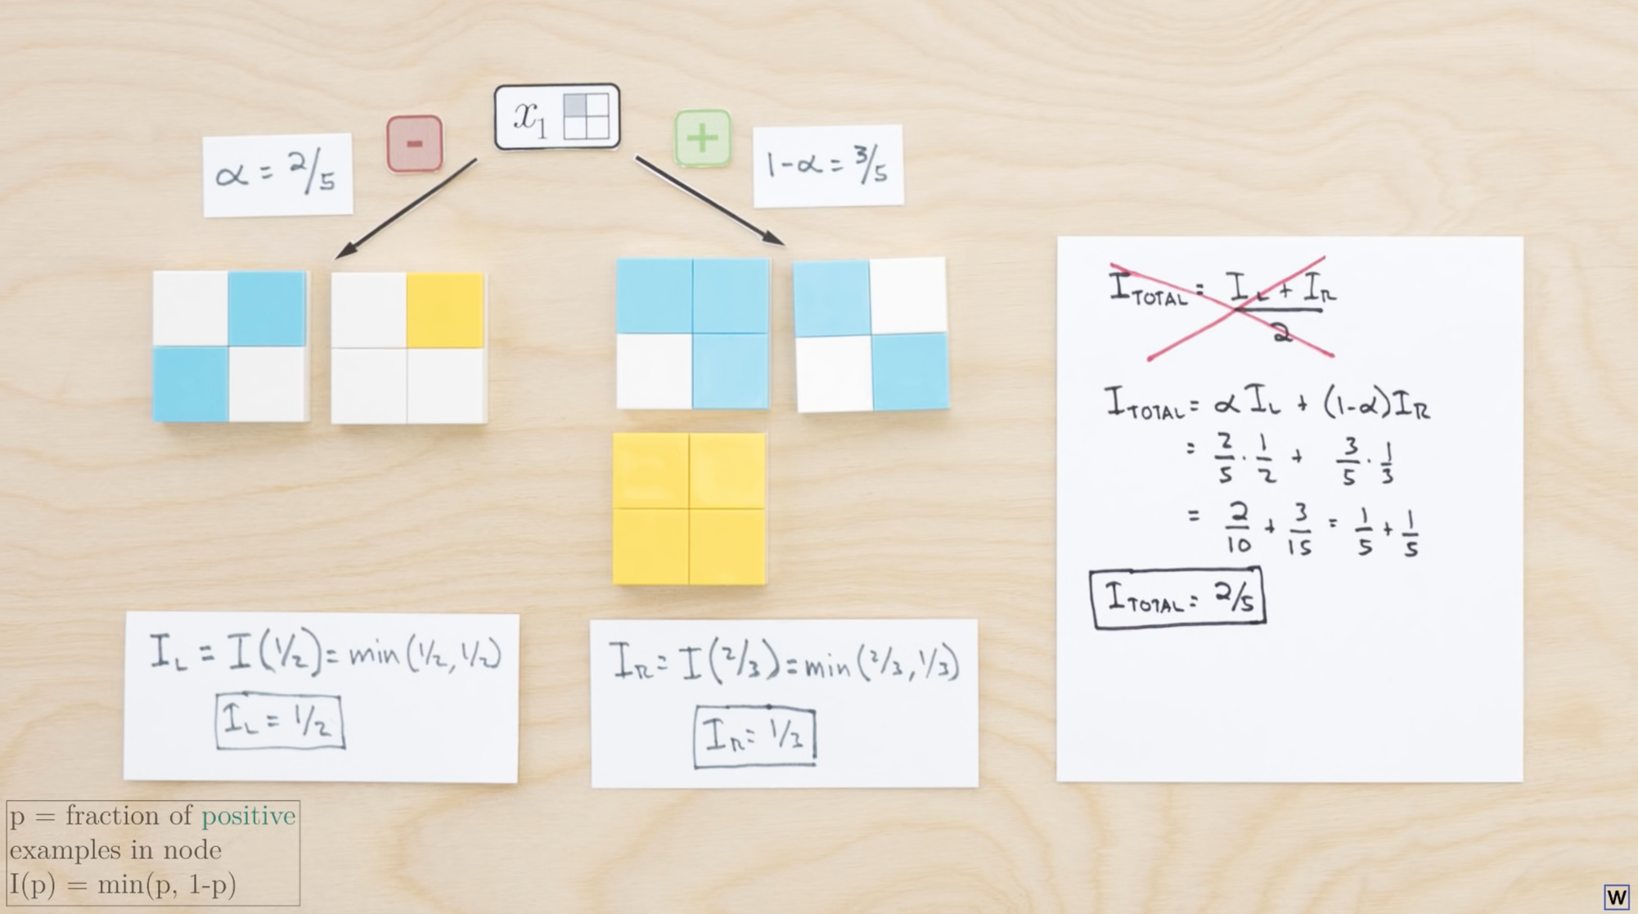
Here’s our Heuristic at work. Notice the weighted average.

Slide 33
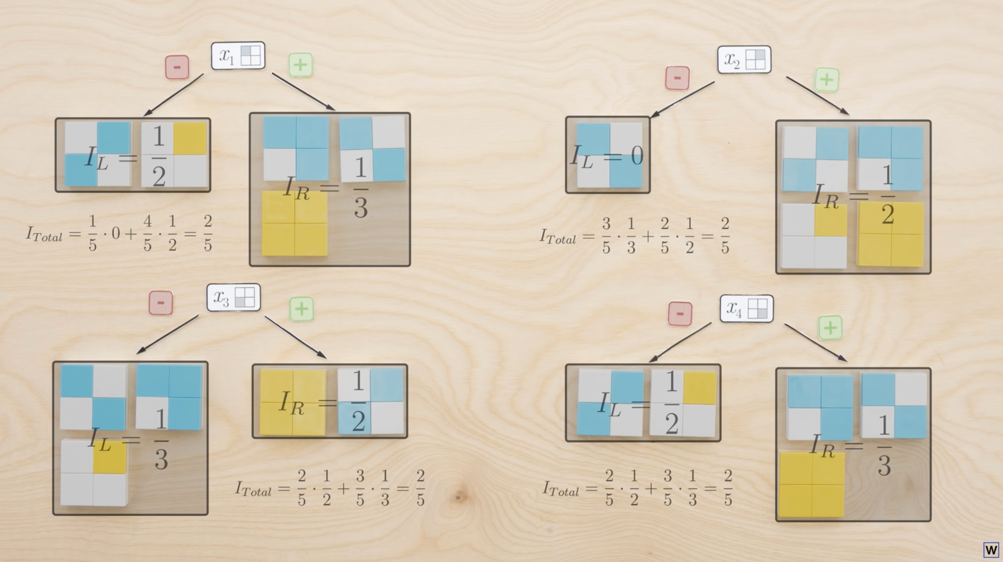
Unfortunately our impurity heuristic does not fix out problem!

Slide 34
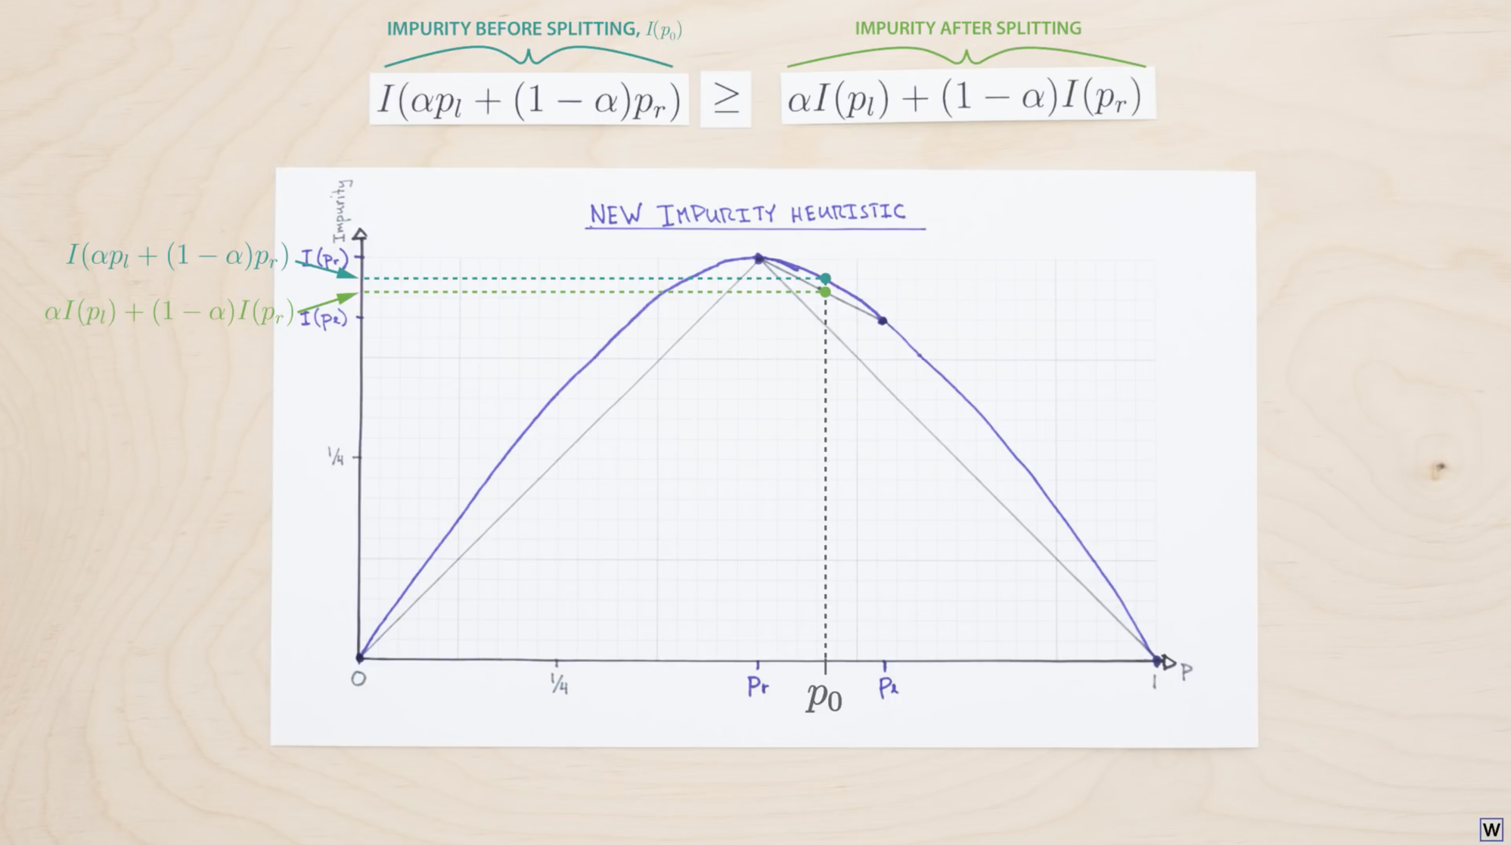
Now, because this is a CV and not an ML class, we’ll skip a few details here, check out Learning to See part 14 and 15 for the full story. It turns out for our impurity heuristic to decrease as we split, it must be a concave function.

Slide 35
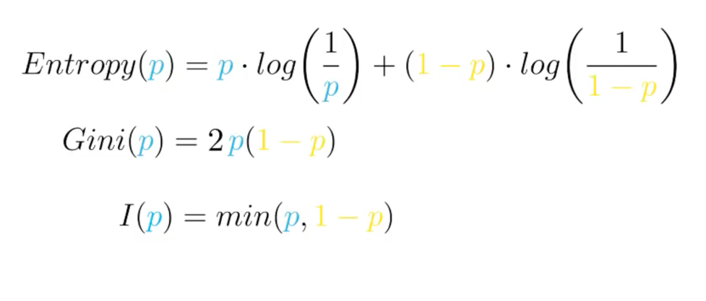
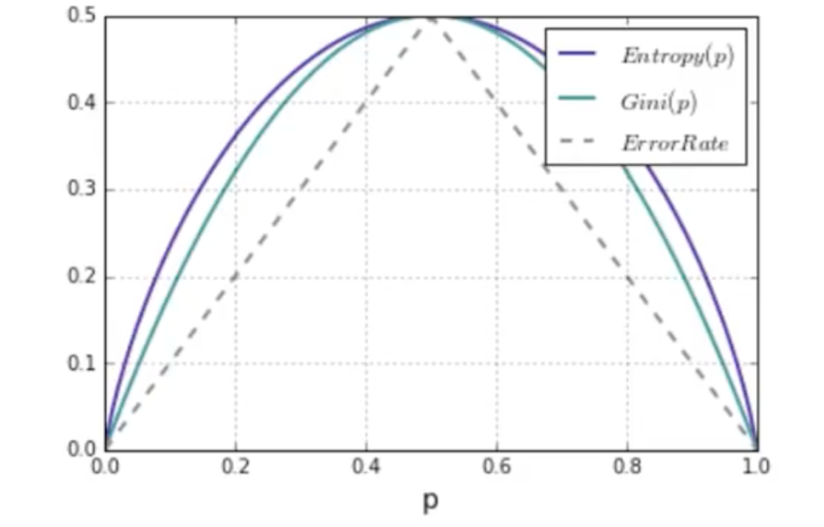
Independently developed in statistics and ML, Gini Impurity and Entropy turn out to be very good heuristic measures of impurity.

Slide 36
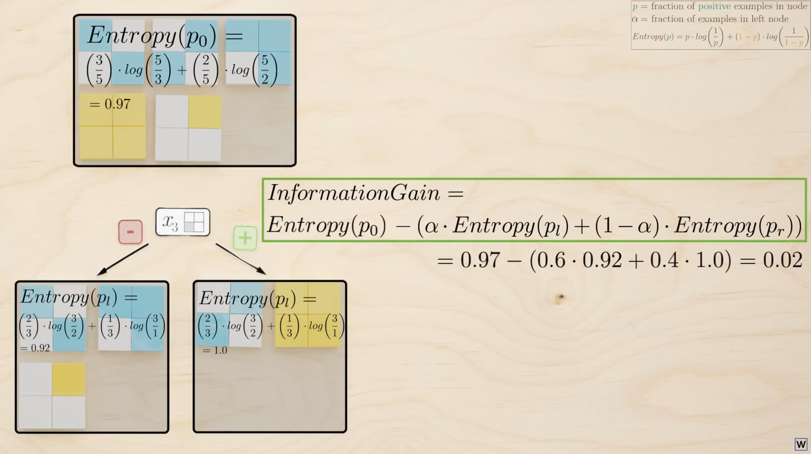
Here’s our entropy heuristic at work.

Slide 37
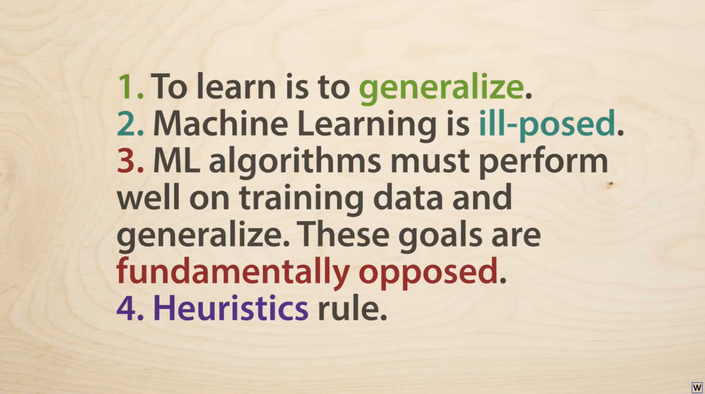

Slide 38
Ok, decision tree time.

Slide 39
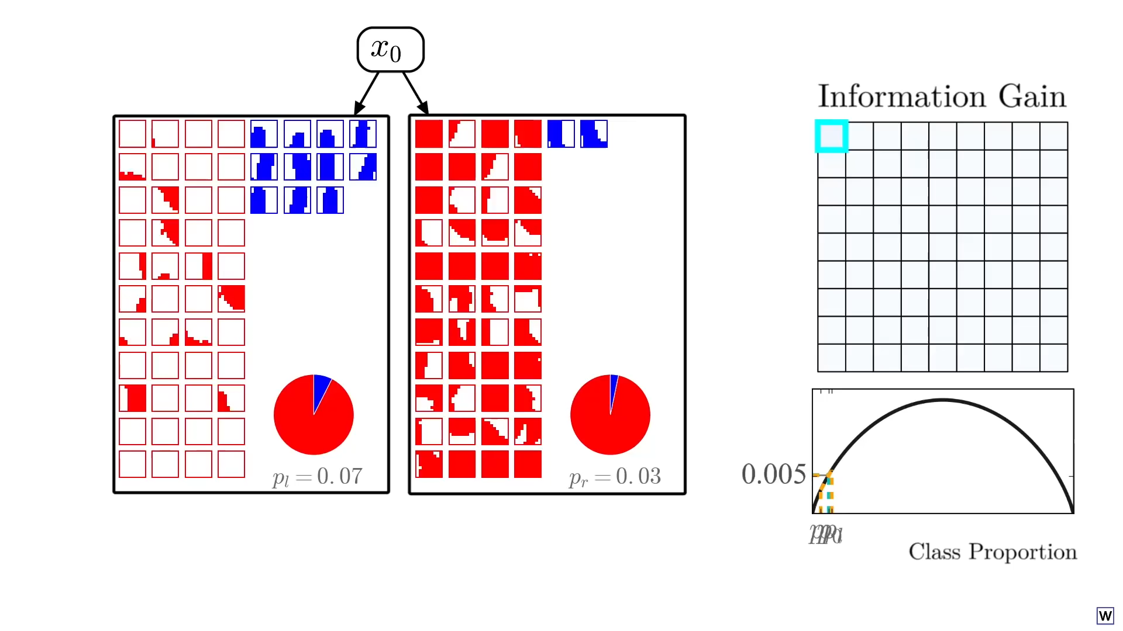

Slide 40
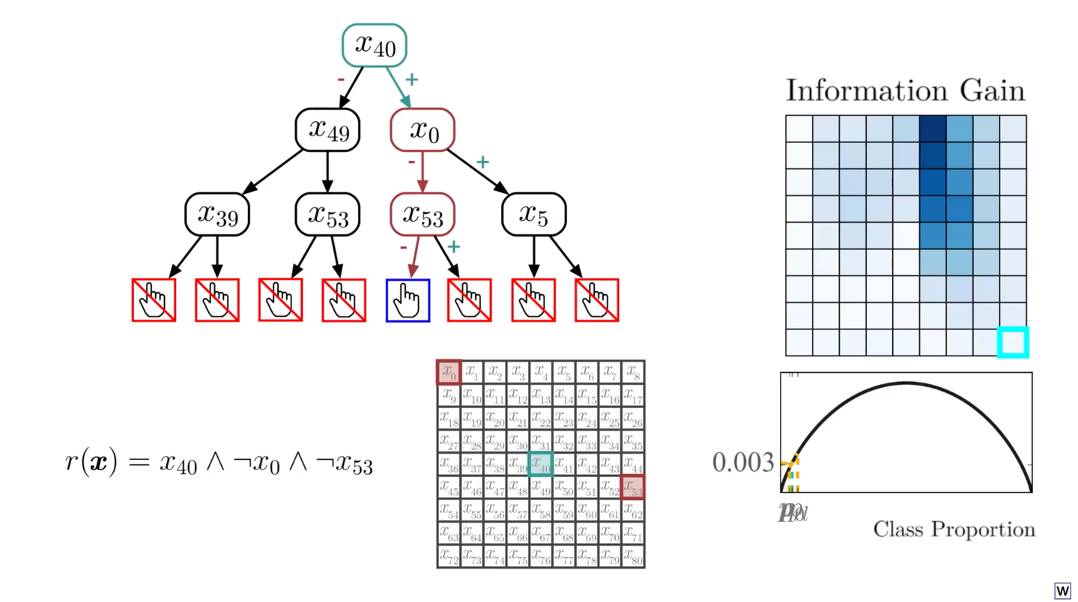
How many rules did we test along the way?
< 100
101-1,000
1,001-10,000
> 10,000

Slide 41
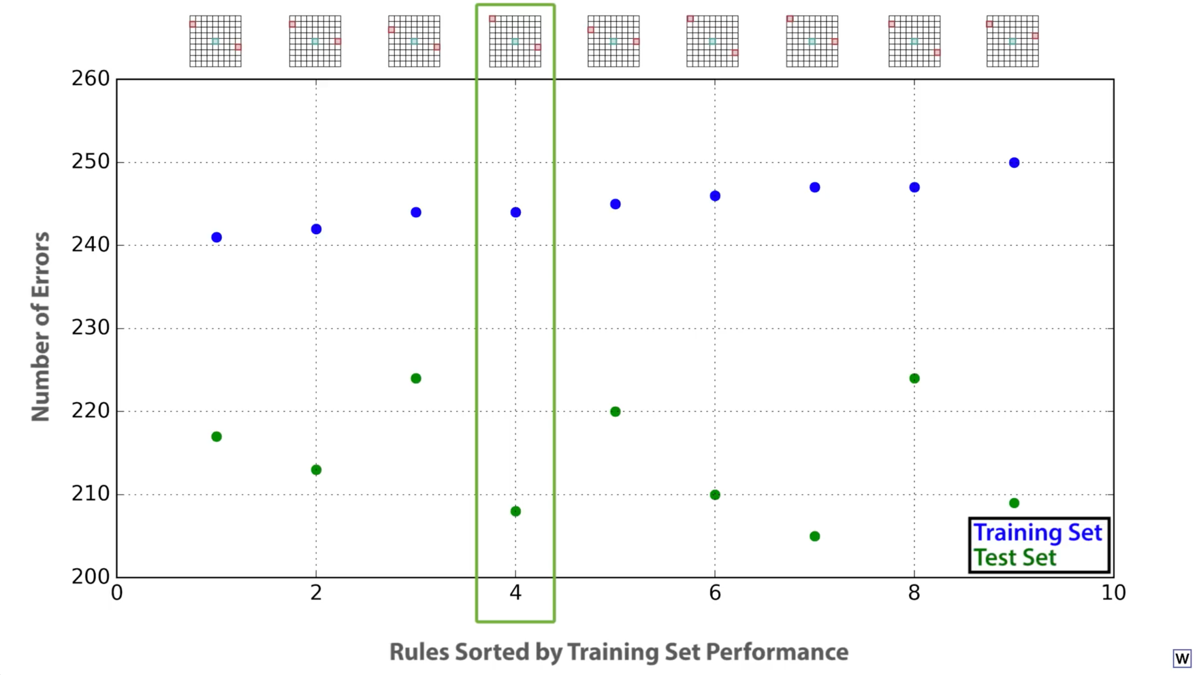
We found the 4th best rule!

Slide 42
Time to look at some code.
decision_trees.ipynb

Slide 43
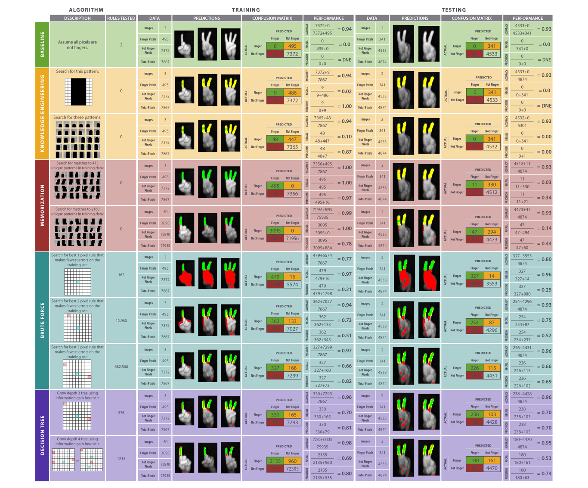
We win!

